Slide 1
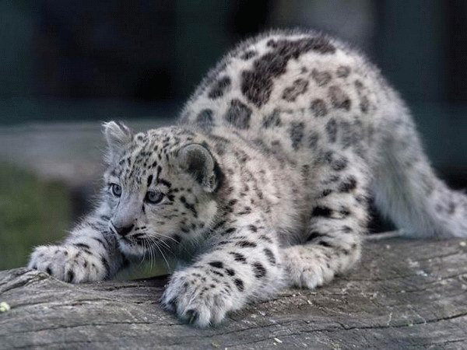
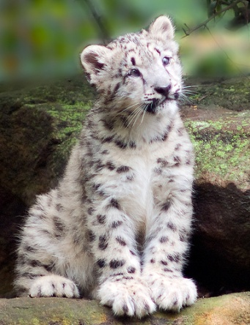
Snow leopards

Slide 2
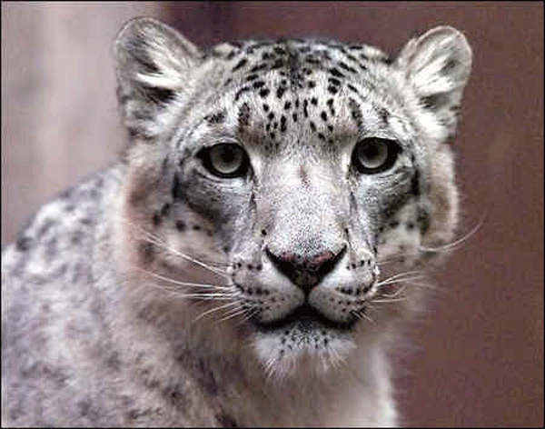
Predators
The main predators of snow leopards are people.
This is why people kill them:
because they kill the farmers’ livestock
to export their skin to other countries

Slide 3
Habitat
Snow leopards are found at altitudes(height) between 9800 and 17,000 feet in the high, rugged mountains of Central Asia. Their range spans from Afghanistan to Kazakhstan and Russia in the north to India and China in the east.

Slide 4
Diet
Snow leopards mainly hunt wild sheep and goats. Snow leopards are also known to eat smaller animals like rodents, hares and game birds.

Slide 5
Anatomy and Lifespan
Height: About 2 feet (.6m) at shoulders. Length: 6-7.5 feet (1.8-2.3m) (includes 40-inch (1m) tail length). Weight: 77-120 lbs (35-55 kg). Female snow leopards are about 30% smaller than males. Lifespan: Their reclusive nature makes it hard to determine snow leopard lifespan in the wild. They have, however, been known to live for as long as 21 years in captivity.

Slide 6
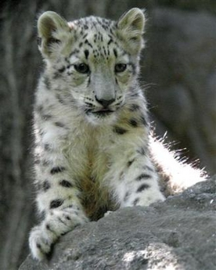
Reproduction
Mating Season: Between January and mid-March. Gestation period : 3-3 ½ months. Litter size: 2-3 cubs. Females give birth in rocky dens lined with their fur. The young follow their mother on hunts at three months and remain with her through their first winter.

Slide 7
Facts
Did You Know? Snow leopards have light green or gray eyes, unusual for big cats, who usually have yellow or gold eyes.
Did You Know? Snow leopards have very large paws that act as snowshoes and keep them from sinking into the snow. Their paws are also completely fur-covered, protecting them from the cold.

Slide 8
Snow leopards left in the wild
Estimated snow leopard populations:
Afghanistan | 100 – 200
Bhutan | 100 – 200
Burma/Myanmar | No Studies
China | 2,000 – 2,500
India | 200 – 600
Kazakhstan | 180 – 200
Kyrgyzstan | 800 – 1400
Mongolia | 500 – 1,000
Nepal | 350 – 500
Pakistan | 250 – 420
Russia | 50 – 150
Tajikistan | 120 – 300
Uzbekistan | 10 – 50
Total | 5,060 – 7,220

Slide 9
This is the end. Thank you for watching. Martin

